Slide 1
HL ONLY!
TOPIC A3:
DATABASES
LESSON A3-10
ACID & DISTRIBUTED DATABASES

Slide 2
AGENDA
ACID
Atomicity
Consistency
Isolation
Durability
TCL Commands
Begin Transaction
Commit
Rollback
Distributed Databases
ACID in Distributed Databases
Features of Distributed Databases
NOTE!
Have a way to take notes and a way to write code available for this lesson

Slide 3

THE WARM UP QUESTION
In data mining which of the following techniques are used to get the following knowledge:
Group people into groups based on high/low loan risk
Predict what page to load next on a webpage based on where most users go
Economists predict inflation rate in one year from now based on past data

Slide 4
THE WARM UP ANSWER
Clustering
Sequential Pattern Discovery
Regression

Slide 5
ACID PROPERTIES
Databases are governed by a set of principles known as ACID
A – Atomicity
C – Consistency
I – Isolation
D - Durability

Slide 6

ATOMICITY
Atomicity – a database transaction (adding, removing, changing data) is all-or-nothing
Either every part of the transaction succeeds, or none are applied
If there is a failure, the entire transaction is rolled back to its previous state
This is done for database consistency
Why called atomicity?

Slide 7
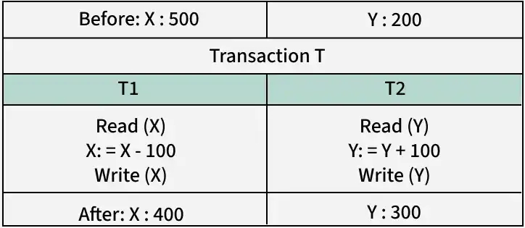
ATOMICITY
With atomicity, each transaction has two options:
Commit: if the transaction has no errors, changes are applied permanently
Abort/Rollback: If any part of the transaction fails, any changes made as part of the transaction are reverted
In transaction T, if T1 is successful, but T2 fails, the database would be left in an inconsistent state
Because of atomicity, T1 would be rolled back

Slide 8
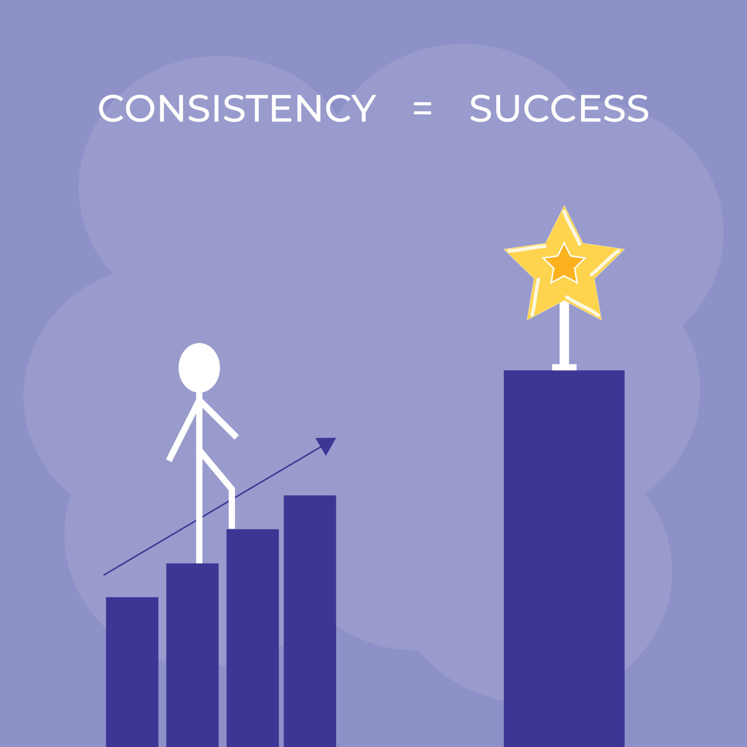
CONSISTENCY
Consistency – the database must remain in a valid state before and after a transaction
A valid state follows all defined rules, constraints, relationships
No integers in varchar field
No missing primary keys
No foreign key values that don’t exist
If a transaction violates any of this, it is rolled back to prevent corrupt/invalid data

Slide 9

CONSISTENCY
Example: The amount of money in a bank system should always be constant.
Before a transfer, the total balance is $700.
After the transfer, the balance should still be $700, just in a different part of the system
If the transaction fails in the middle, the total will not be $700
The computer sees this, and rolls the transaction back

Slide 10

ISOLATION
Isolation – transactions run independently without impacting each other. Changes made by one transaction are not visible to others until they are committed. (completed)
Even if two people run a transaction at the same time, the database will choose one to go first, and the other to go after.

Slide 11
ISOLATION
Example: Transaction 1 removes $200 from account A, while Transaction 2 adds $400 to account A. Account A begins with $500
Transaction 1 reads the value stored in Account A: $500
Transaction 2 reads the value stored in Account A: $500
Transaction 1 subtracts from this value in memory: $300
Transaction 2 adds to this value in memory: $900
Transaction 1 writes the new value to Account A: $300
Transaction 2 writes the new value to Account A: $900
Transaction 1 was totally negated! Doing each separately prevents this.

Slide 12

DURABILITY
Durability – once a transaction is committed, its changes are permanently saved, even if the system crashes.
Data is stored in non-volatile memory (more on this in Topic A2)
The database can recover from this without losing data
Even if a crash happens after a commit of money to a bank account, that data is stored and will not be lost

Slide 13

TRANSACTION CONTROL LANGUAGE
Because everything in this topic gets its own language…
Transaction control language (TCL) is how we manage these database transactions
There are three main commands to know:
BEGIN TRANSACTION
COMMIT
ROLLBACK

Slide 14
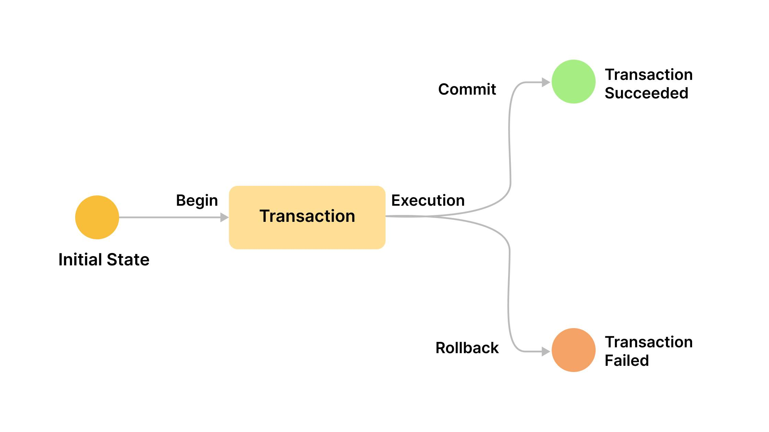
BEGIN TRANSACTION
BEGIN TRANSACTION – the keyword used when a full, new transaction is started
A transaction can contain more than one query, and requires that all steps be executed together
One transaction would contain the SQL UPDATE statements to add money to one bank account, while subtracting it from another

Slide 15

COMMIT
COMMIT – the keyword used when a transaction is completed, and the changes should be permanently saved to the database
A COMMIT should only execute if there were no errors in the transaction
If any error is made, a ROLLBACK should occur instead
If any of you are familiar with GitHub personally, this should ring a bell

Slide 16
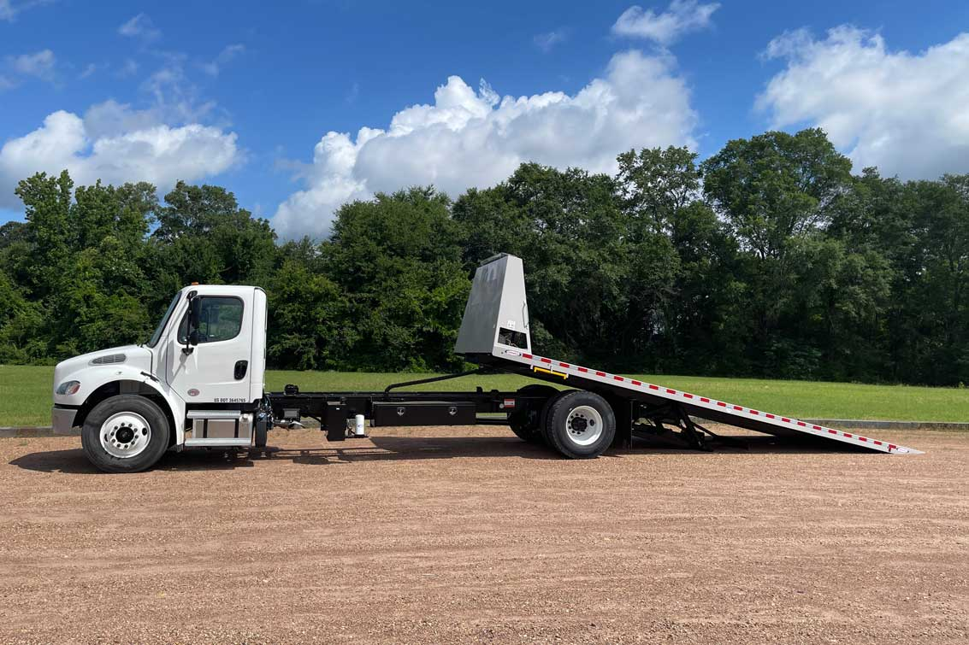
ROLLBACK
ROLLBACK – the keyword used when a transaction has, in part, failed, and the changes should be reverted
ROLLBACKs occur if ANY part of the transaction has failed
The explanation is simple, we ROLL BACK the changes to the previous database state
Changes were never made to the real database yet

Slide 17
TCL COMMANDS

Slide 18
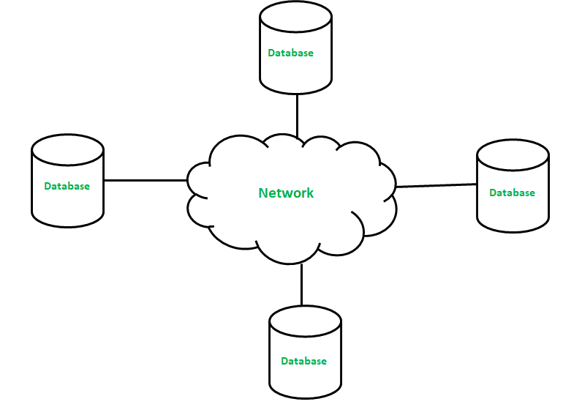
DISTRIBUTED DATABASES
Distributed Database – collection of multiple databases spread across different physical locations, connected via a network
A distributed database manages data across various sites, but makes it appear as a single database to users

Slide 19
DISTRIBUTED DATABASES
Because this data must be accessible at multiple locations, we must ensure that data is consistent between locations
The ACID properties are used doing transactions to update the other databases in the distributed database

Slide 20
DISTRIBUTED DATABASES
Features:
Concurrency Control: because there are multiple databases, we must keep a tighter grip on isolation
Parallel transactions need to act as if they are run by one database
One database can ‘lock’ the others until it is done
Data Consistency: Distributed databases will often sync with each other to ensure data is consistent across the world
Data Partitioning: data from one regional or country branch can be stored on a local database, but still link to others

Slide 21
DISTRIBUTED DATABASES
Features:
Data Security – because databases are distributed, data does not need to be stored all at one location
No ‘pot of honey’ for potential hackers
Fault Tolerance – if one regional database goes down, another can step in while they get the first up and running
If a database is destroyed, they can restore it from another database
Global Query Processing – queries can be run on databases nearby the person making the query, improving performance

Slide 22
DISTRIBUTED DATABASES
Features:
Location Transparency – people can be told where their data is being stored, and be more confident in it being local
Governments also like this
Replication – a clone of a database can easily be made for restoration or testing
Scalability – if a company wants to expand, they don’t have to make their existing databases bigger, they can just add more to the network

Slide 23
BROGRAMMING BASSIGNMENT
You can find PA A3-3 (labeled correctly in ManageBac this time) on Github!

Slide 24

VOCABULARY TO REMEMBER
ACID
Atomicity
Consistency
Isolation
Durability
Transaction Control Language
BEGIN TRANSACTION
COMMIT
ROLLBACK

